Slide 1

Netflix Data : Cleaning, Analysis and Visualization Explore the complexities of Netflix data analytics, focusing on essential tools like python , SQL, and Machine Learning for effective data cleaning, analysis and visualization.
~Rishav Kumar Sharma

Slide 2
The Importance of Data
Analytics at Netflix
Key Methodologies and Insights
• Understanding Viewer Preferences:
Netflix uses data analytics to gain insights into viewer preferences, enhancing content
curation.
• Optimizing Content Recommendations:
By analyzing user behavior, Netflix optimizes content recommendations tailored to individual
tastes.
• Enhancing Use Experience:
Data analytics helps Netflix improve user experience through personal experience through
personalized interfaces and suggestions.
• Advanced Data Cleaning Techniques:
Netflix employs advanced data cleaning methods to ensure the accuracy and quality of their
datasets.
• Utilizing Machine Learning:
Machine learning algorithms are implemented to viewer habits and content popularity.
• Leveraging SQL for Data Management:
SQL databases are utilized for managing large volumes of data efficiently, supporting
complex queries.
• Visualizing Data Insights:
Data visualization tools help Netflix present analytics insights clearly for informed decision Making.

Slide 3
Ensuring Data Quality
Data Cleaning Techniques at Netflix
• Importance of Data Cleaning:
Data cleaning is essential for accurate and reliable analytics.
• Handling Missing Values:
Imputation methods fills gaps to ensure data completeness.
• Outlier Detection:
Statistical methods identify anomalies that may skew analysis.
• Data Transformation:
Normalization and standardization maintain data consistency.\
• Duplicate Removal:
Algorithms eliminate rebundant records to enhance tha data quality

Slide 4
Leveraging Python and SQL for Analysis
How Netflix Utilizes Python and SQL for Data Insights?
• Importance of Python in Data Analysis:
Python’s libraries like Pandas and NumPy are vital for effective data
manipulation and analysis.
• Visualization with Matplotlib:
Matplotlib enables clear visualization of complex data, enhancing and interpretability.
• SQL for Data Extraction:
SQL is essential for extracting and manipulating data from extensive
databases at Netflix.
• Generating Reports with SQL:
SQL queries are crucial for generating reports that inform strategic
decisions.
• Understanding Viewership Patterns:
Data analysis helps Netflix understand viewership patterns and user
engagement.
• Actionable Insights:
Combining Python and SQL provides insights that influence content
creation and engagement strategies.

Slide 5
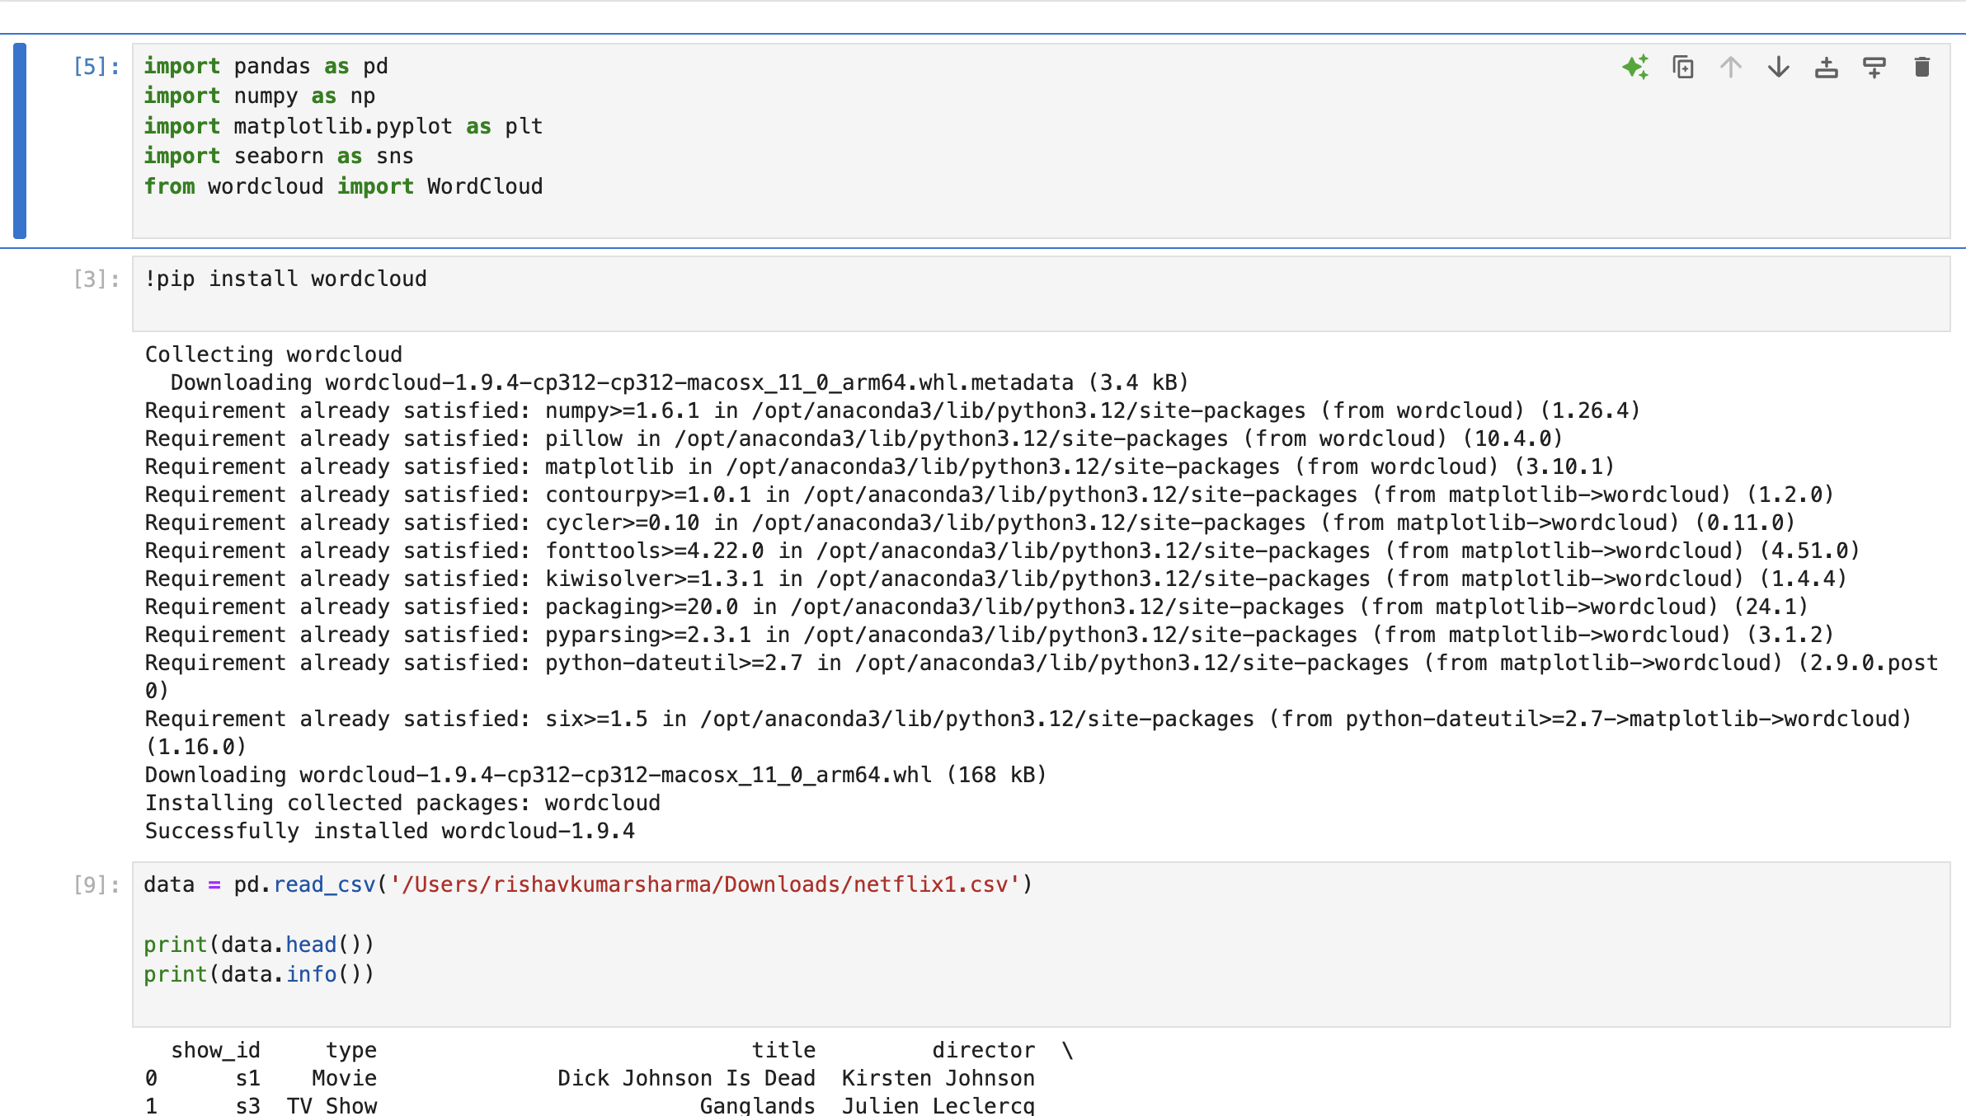
Data Cleaning & Analysis of Netflix Dataset

Slide 6
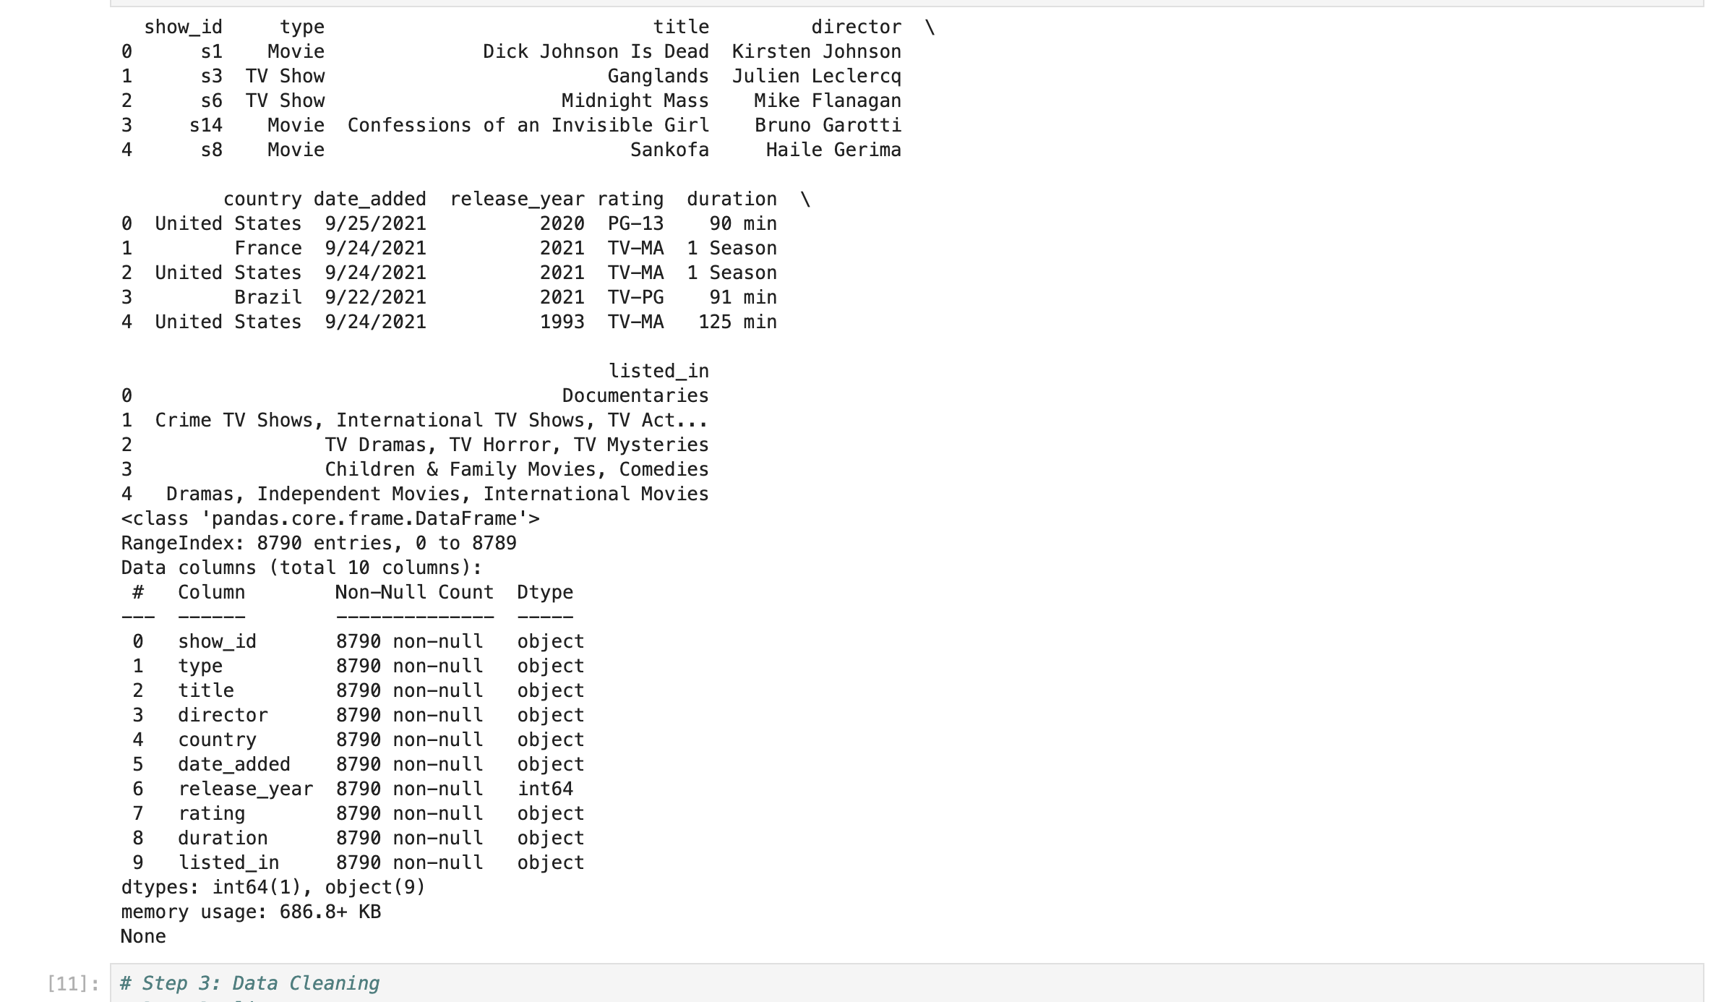

Slide 7
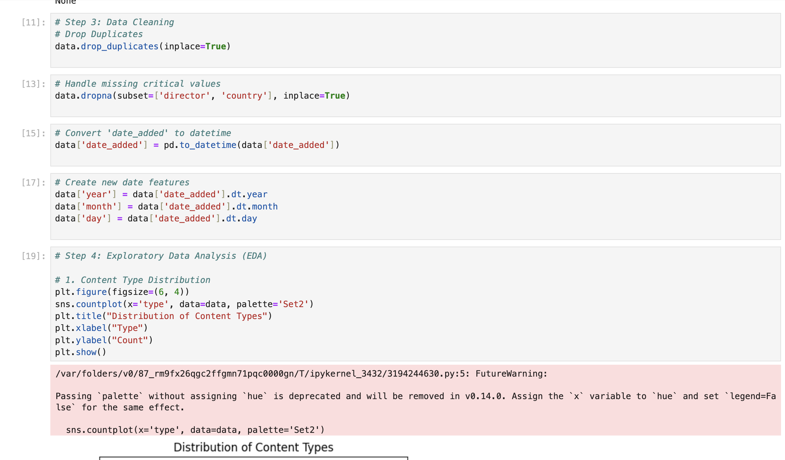

Slide 8
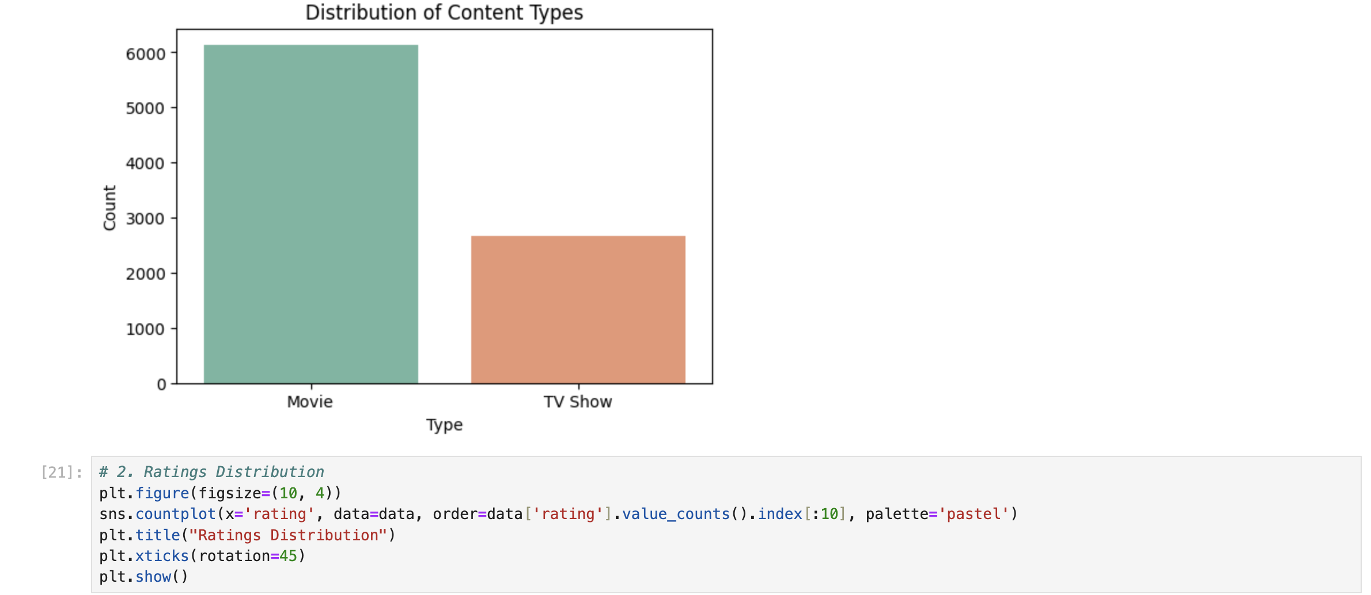
Data Visualisation
Distribution of content types

Slide 9
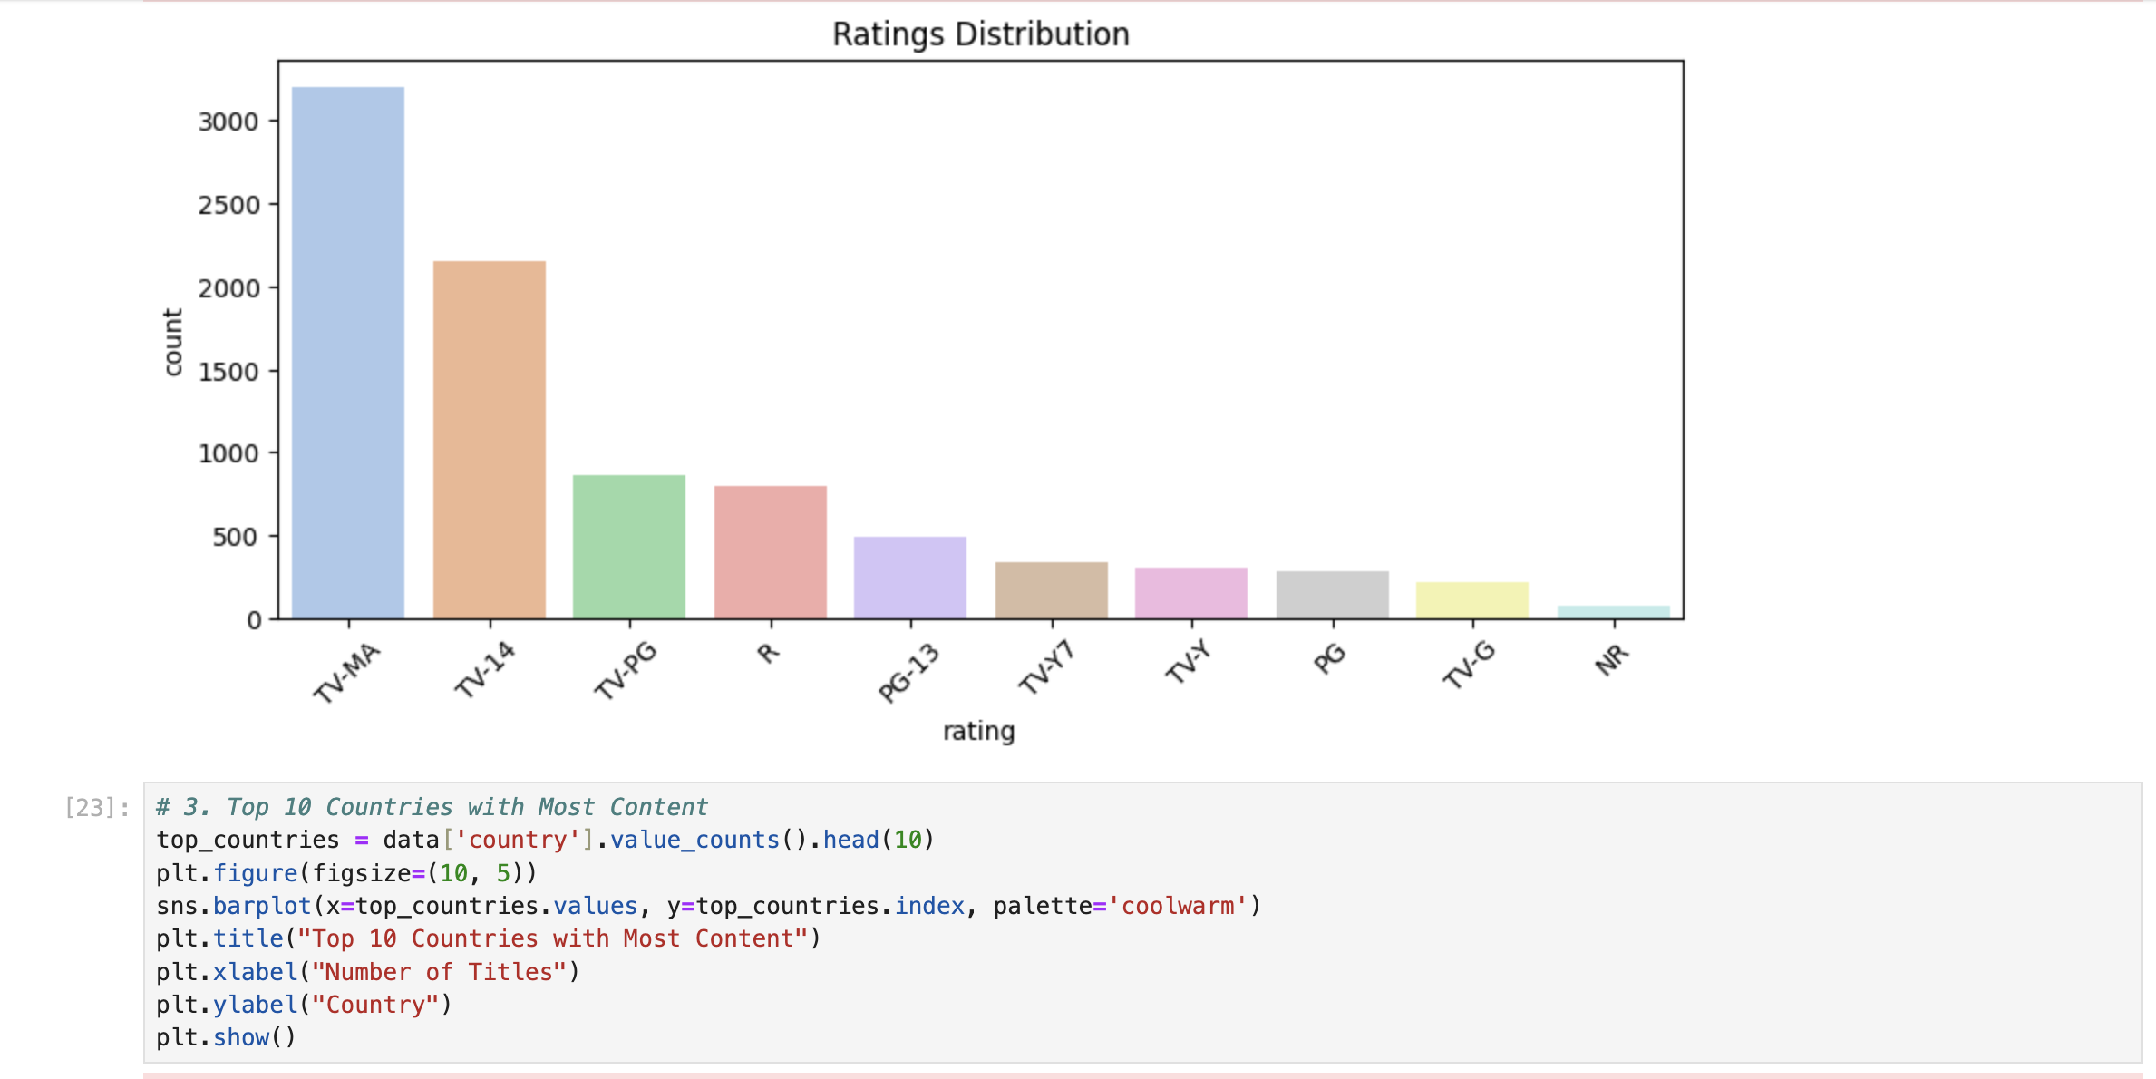
Rating Distribution

Slide 10
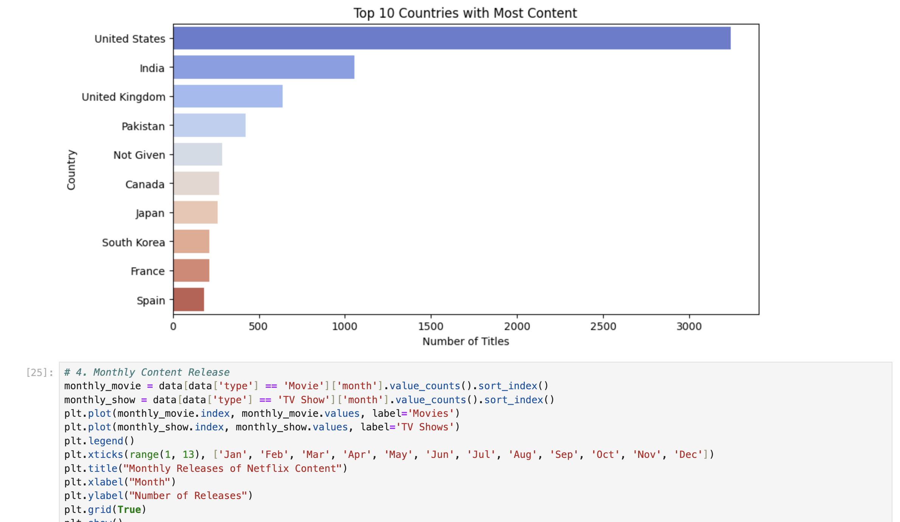
Top 10 Countries with Most Content

Slide 11
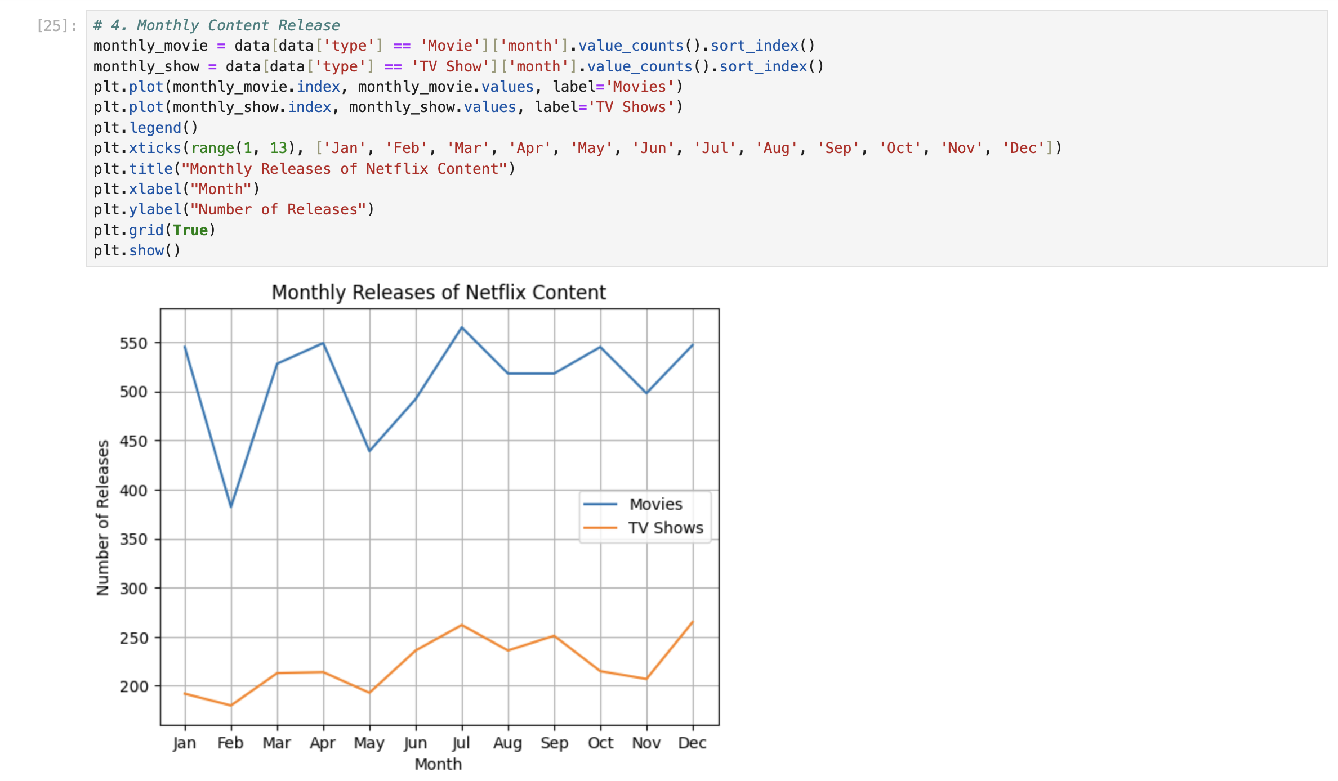
Monthly Releases of Netflix content

Slide 12
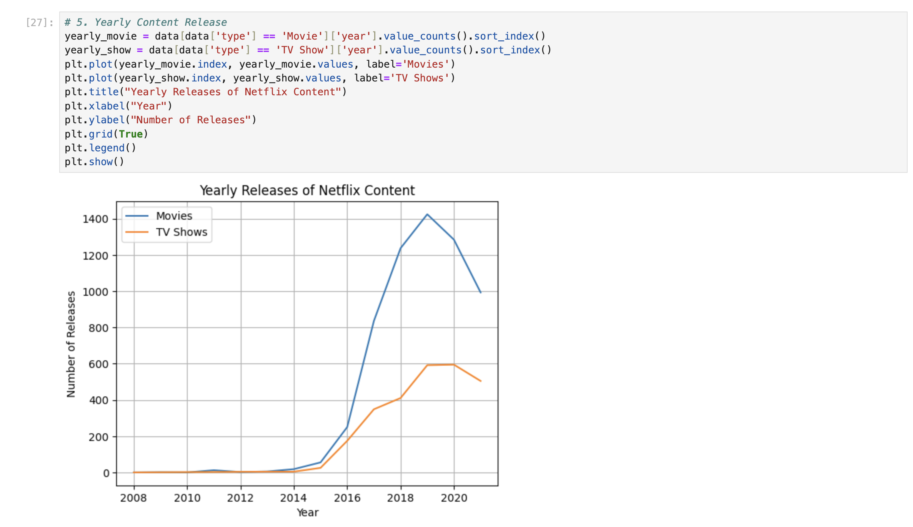
Yearly Releases of Netflix Content

Slide 13
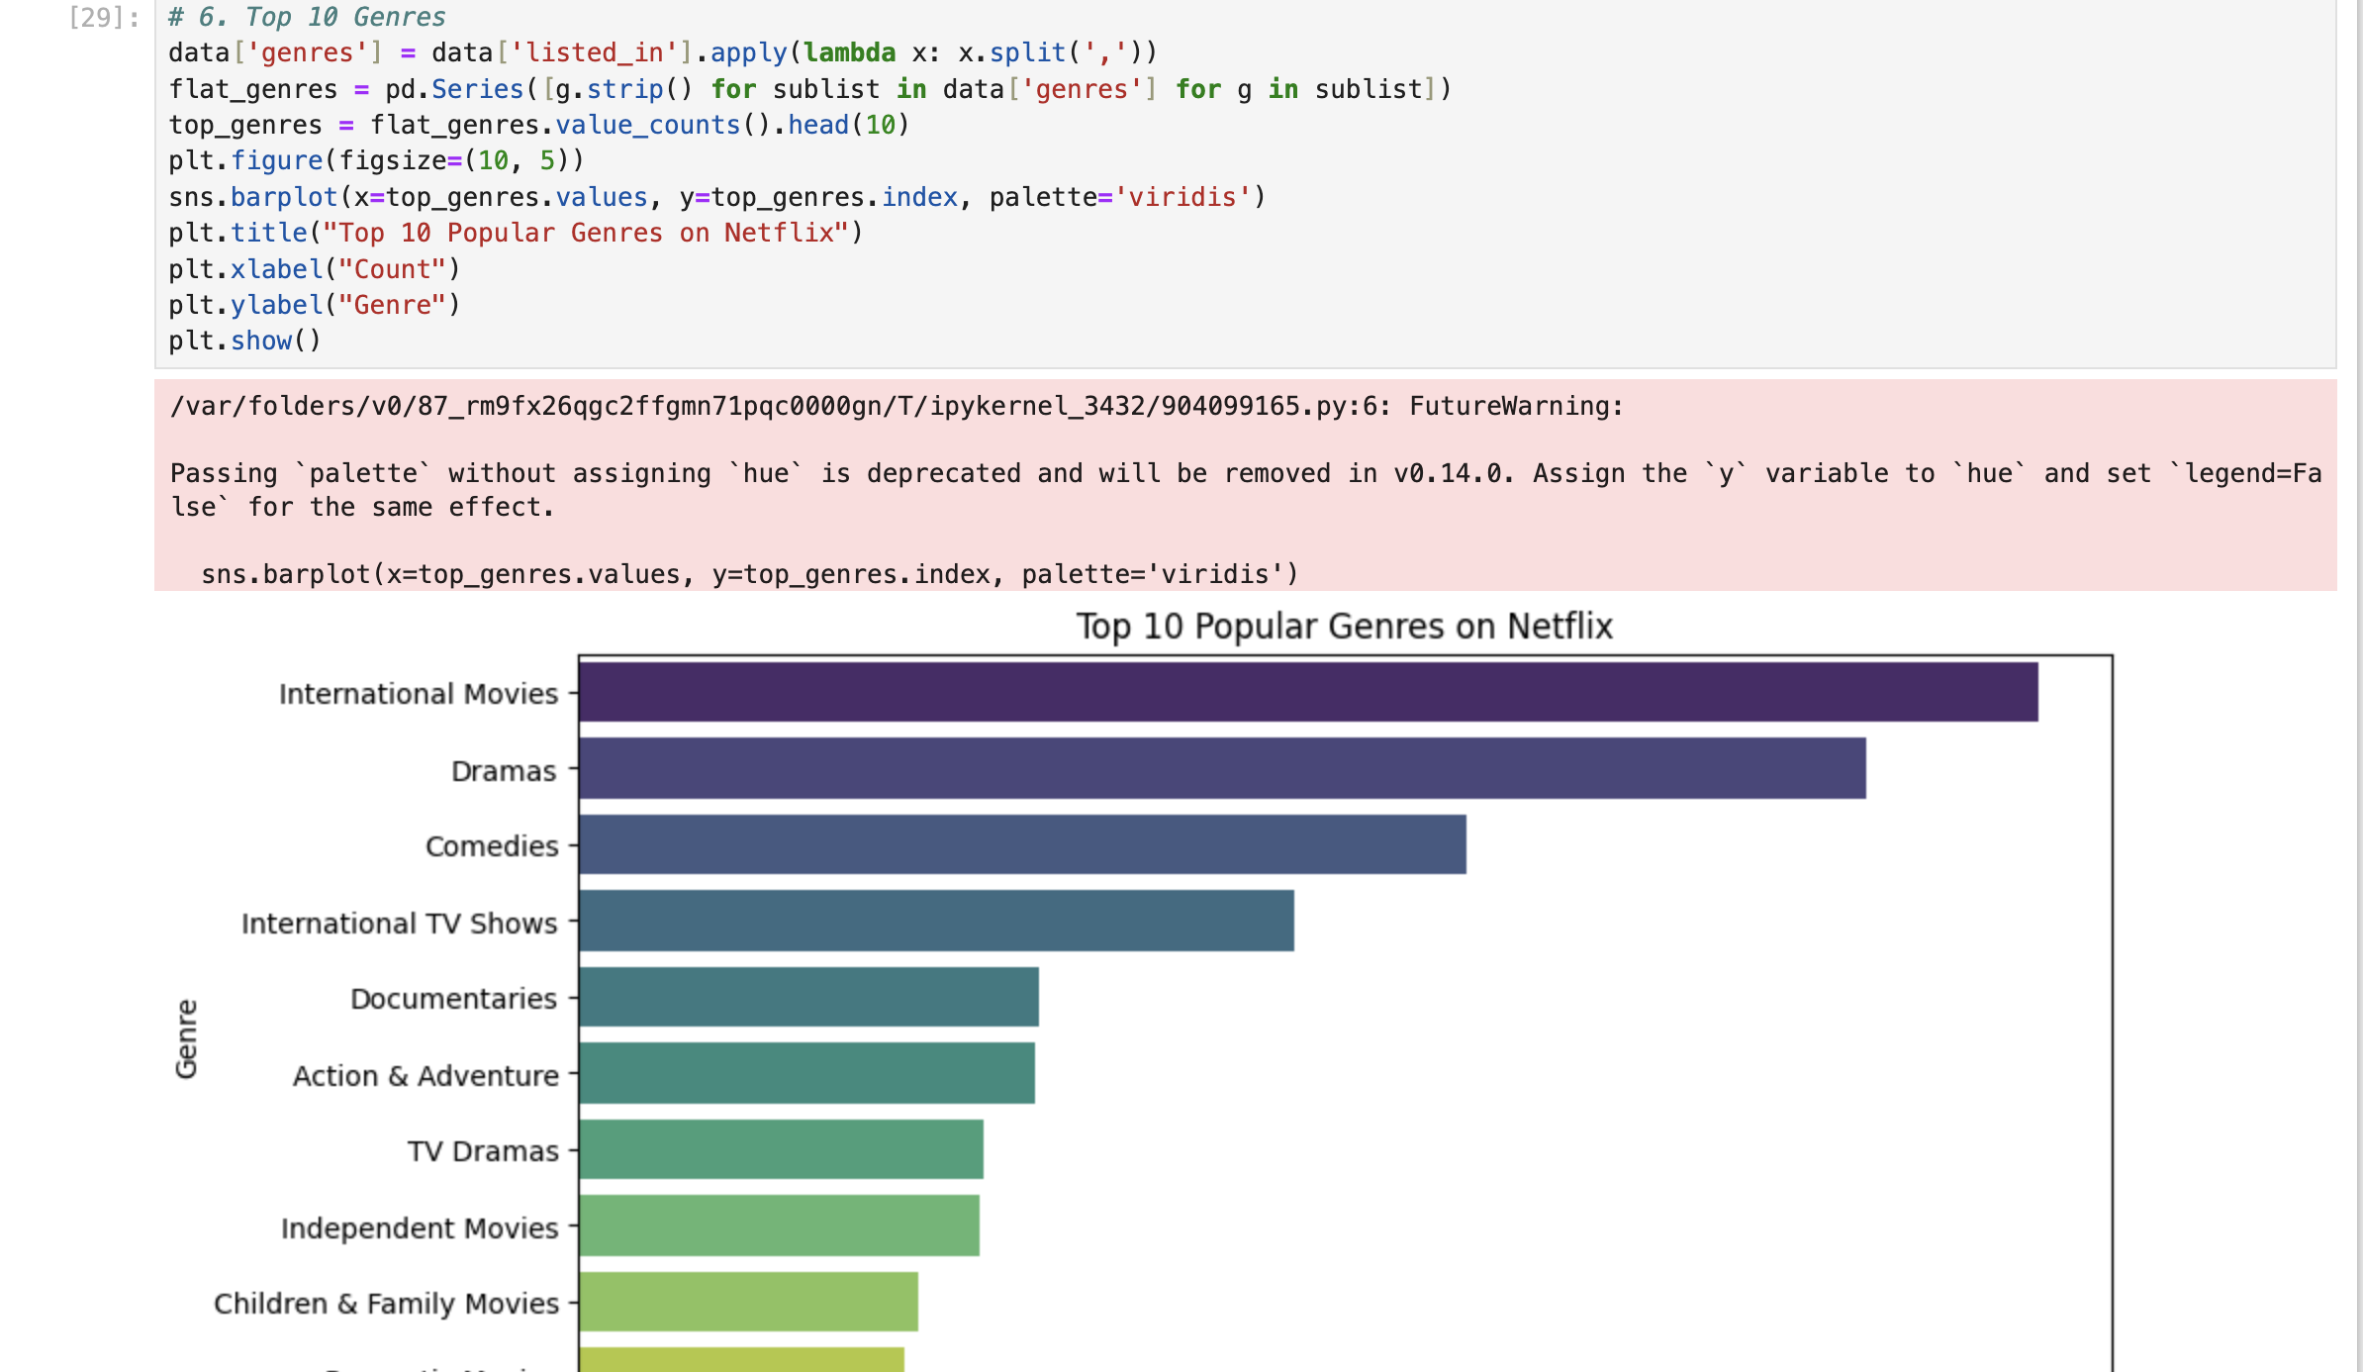
Top 10 Popular Genres on Netflix

Slide 14
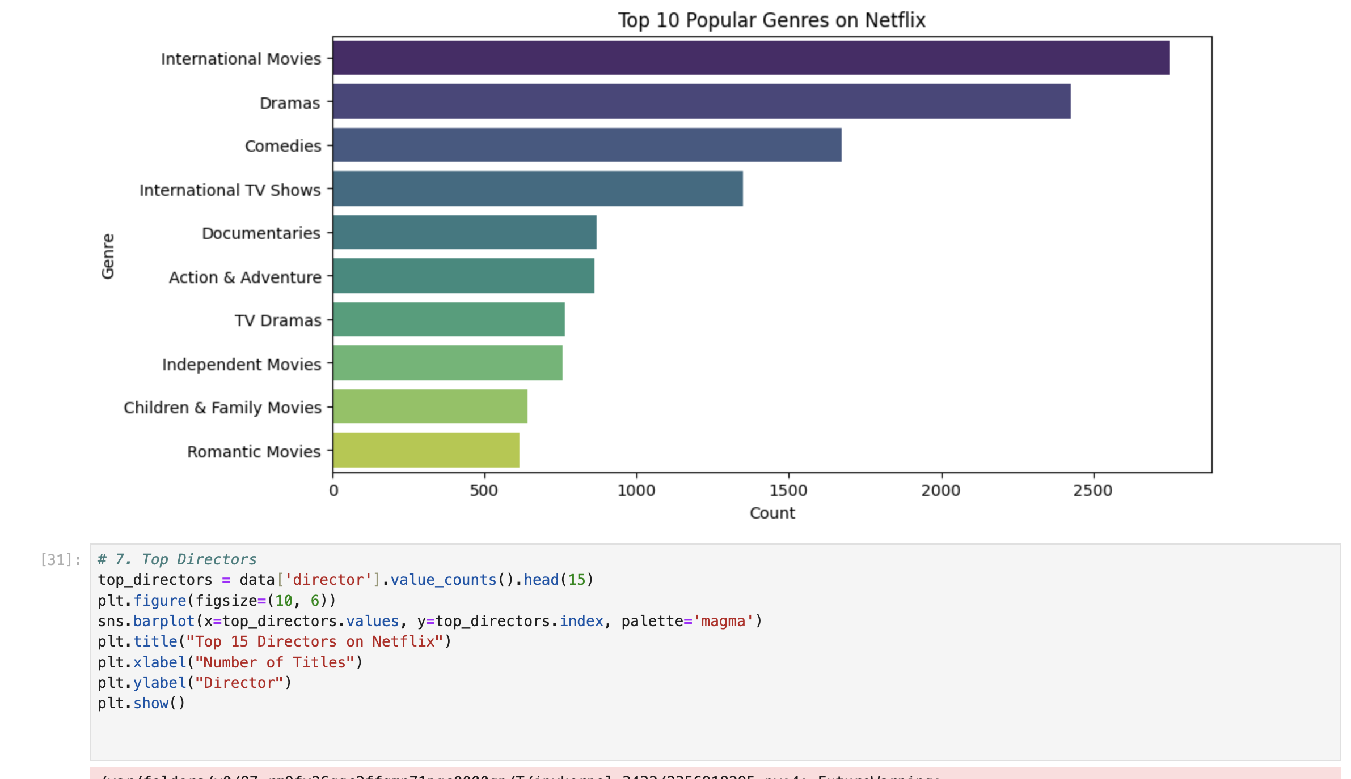
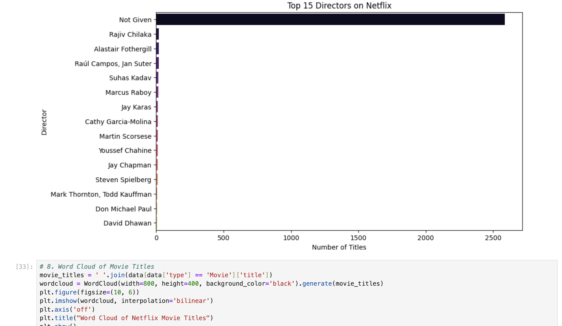
Top 15 Directors on Netflix

Slide 15
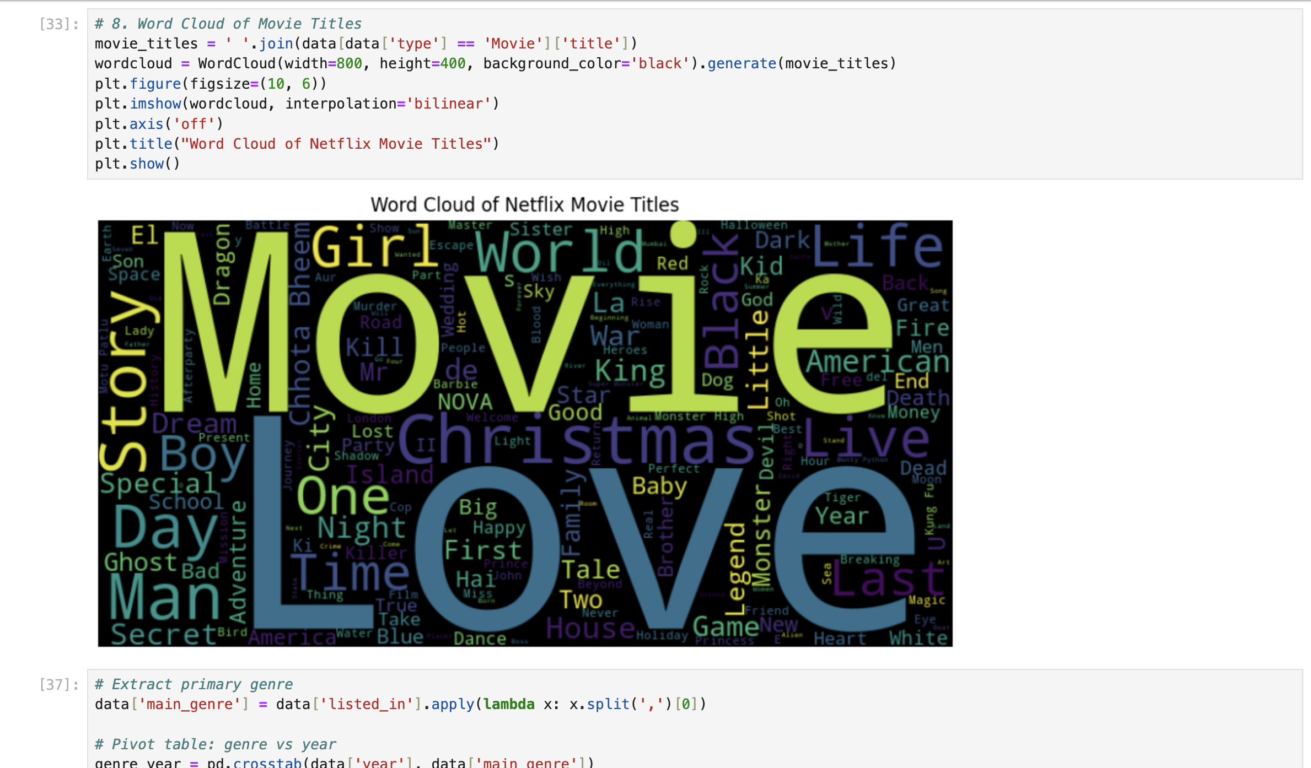
Word Cloud of Movie Titles

Slide 16
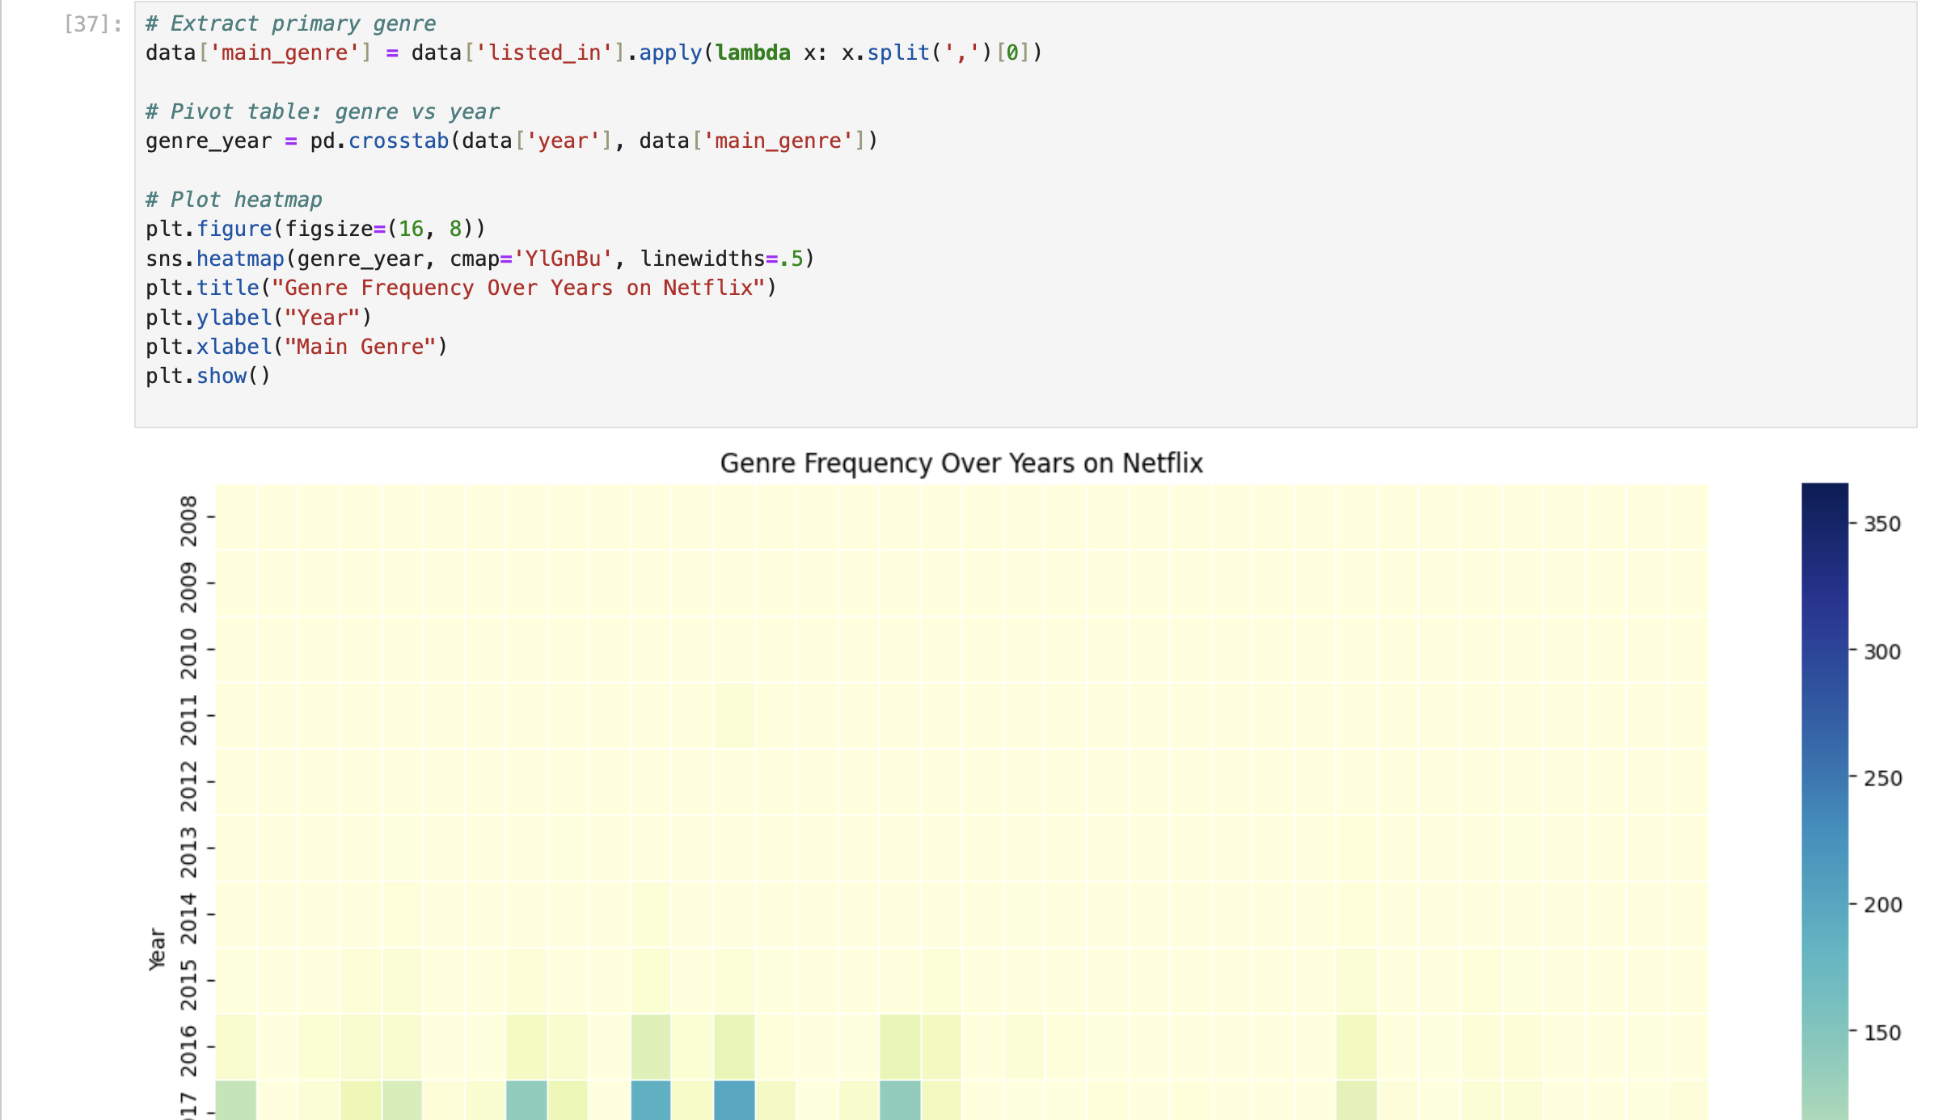
Genre Frequency Over Years on Netflix

Slide 17
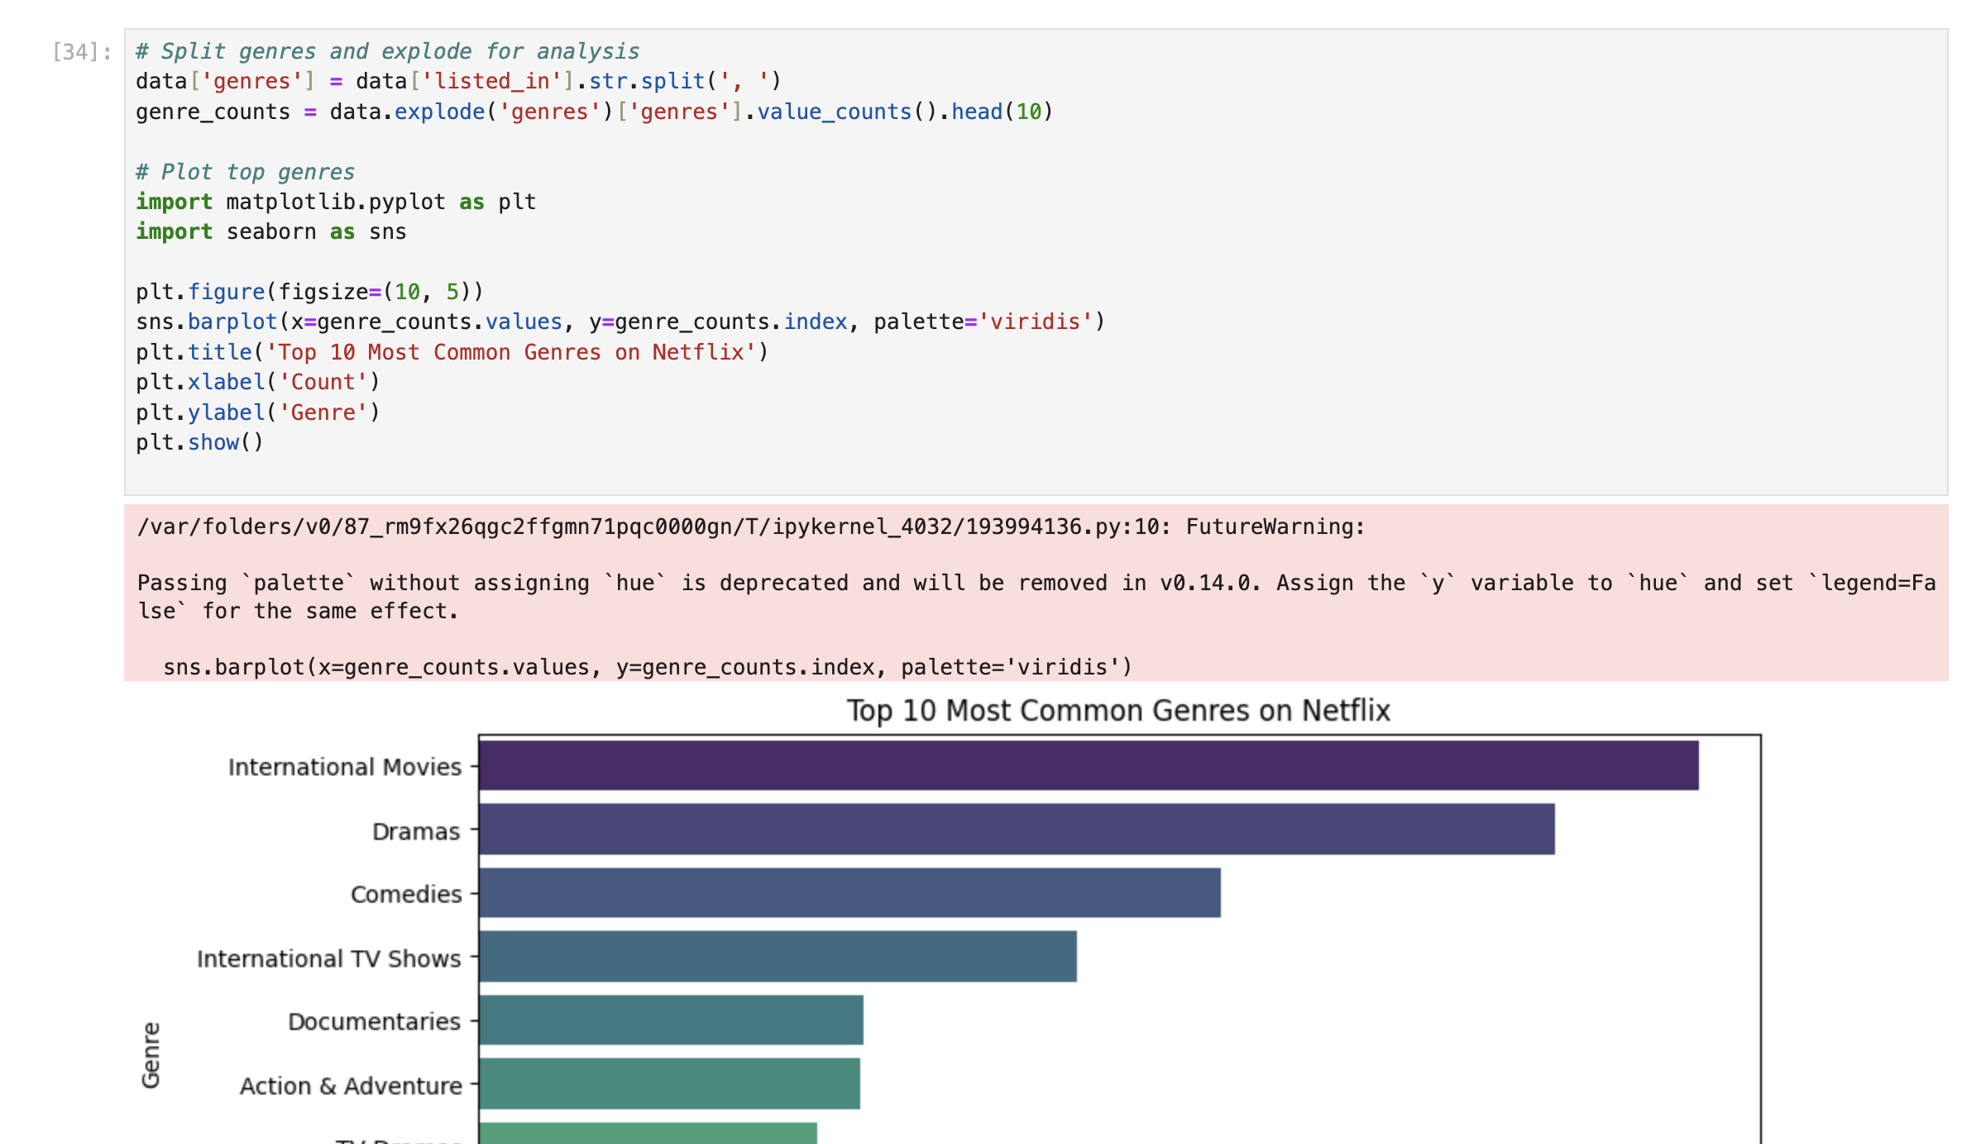
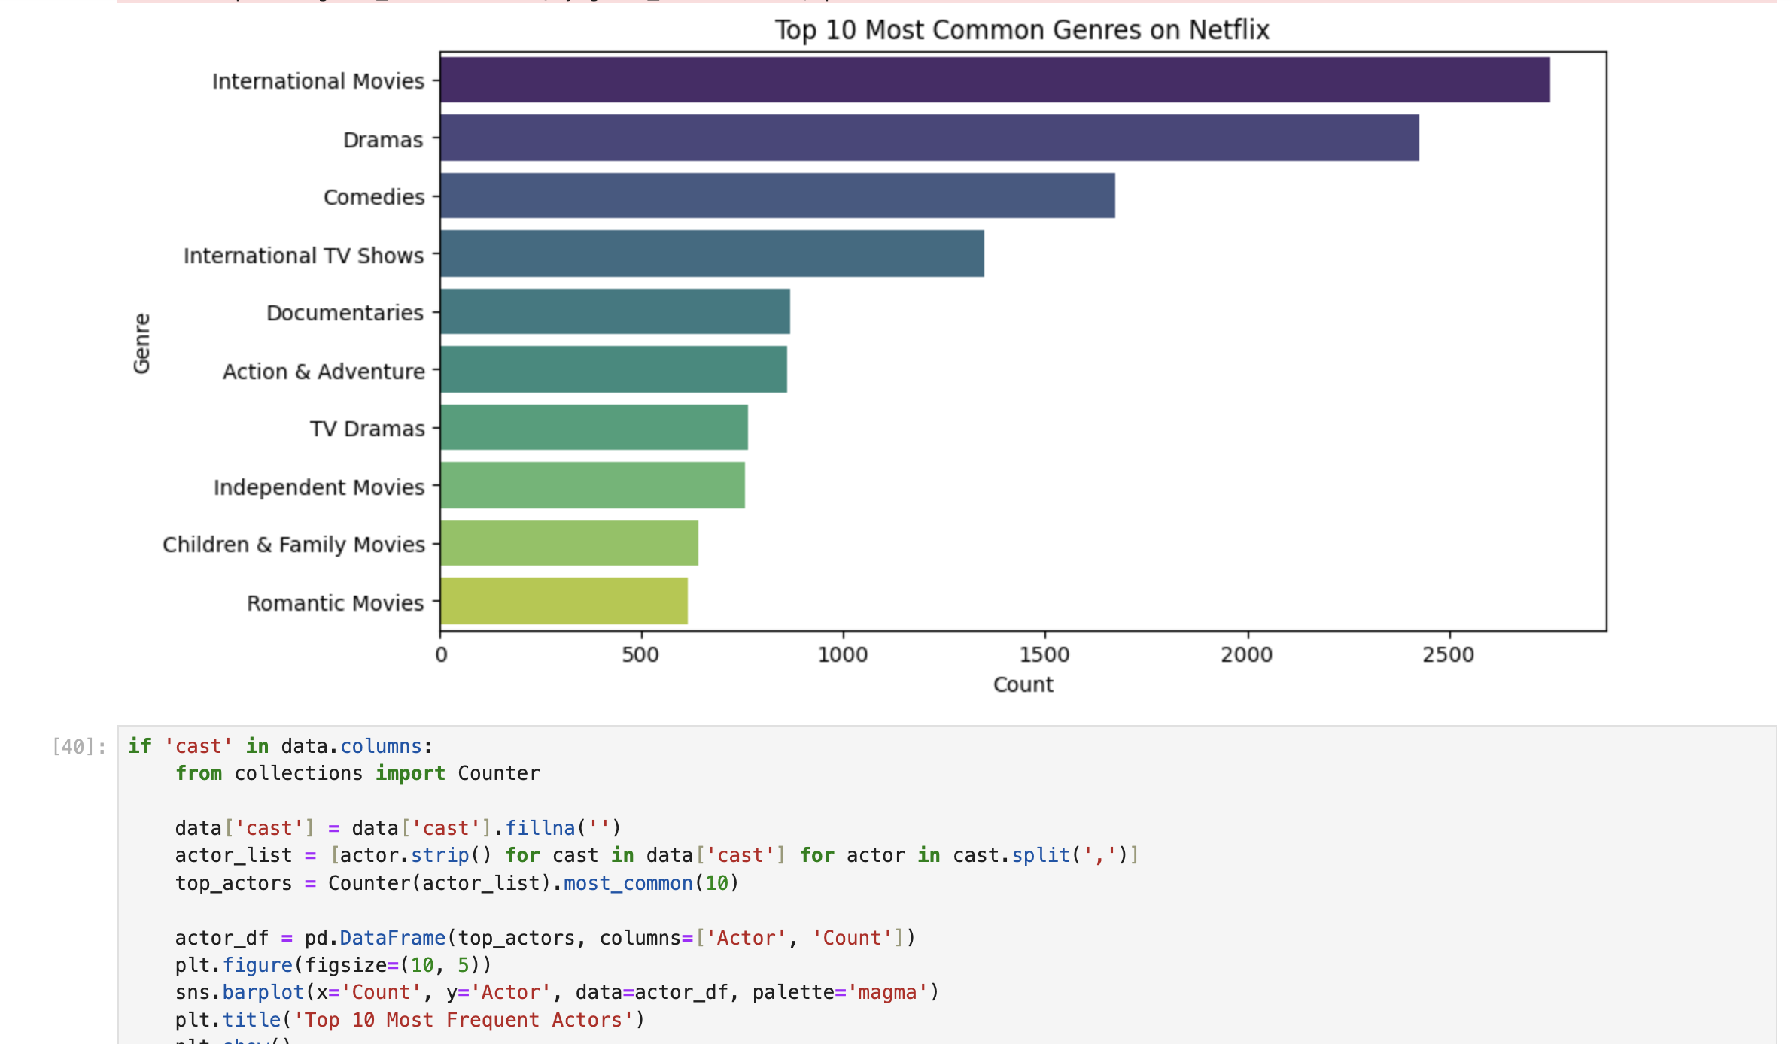
Top 10 Most Common Genres on Netflix

Slide 18
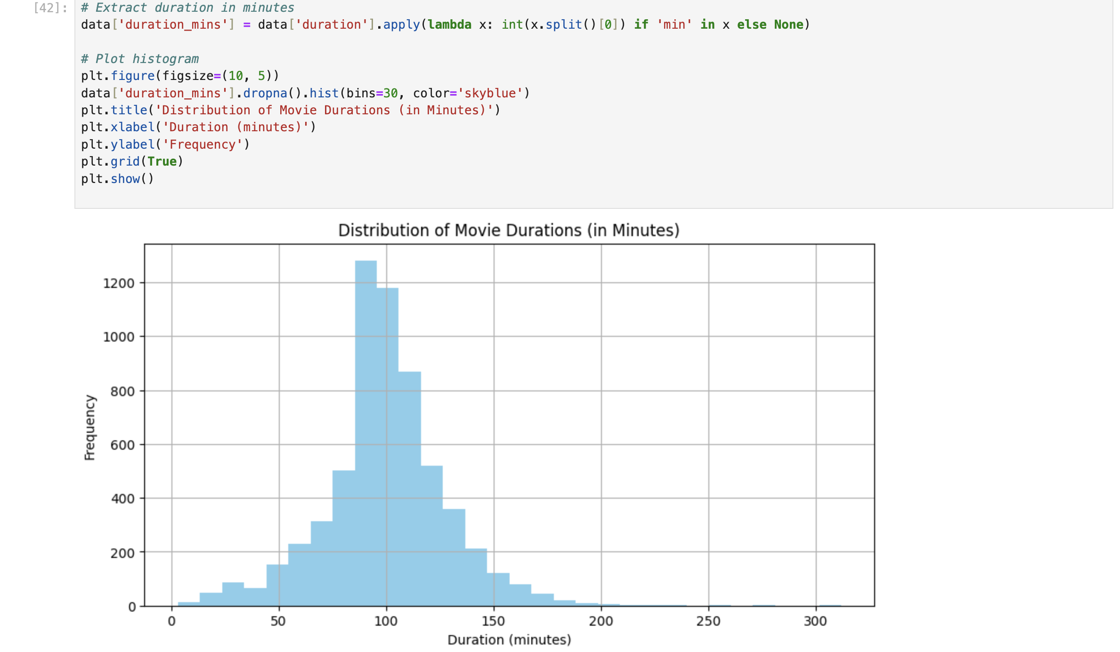
Extract duration in minutes

Slide 19
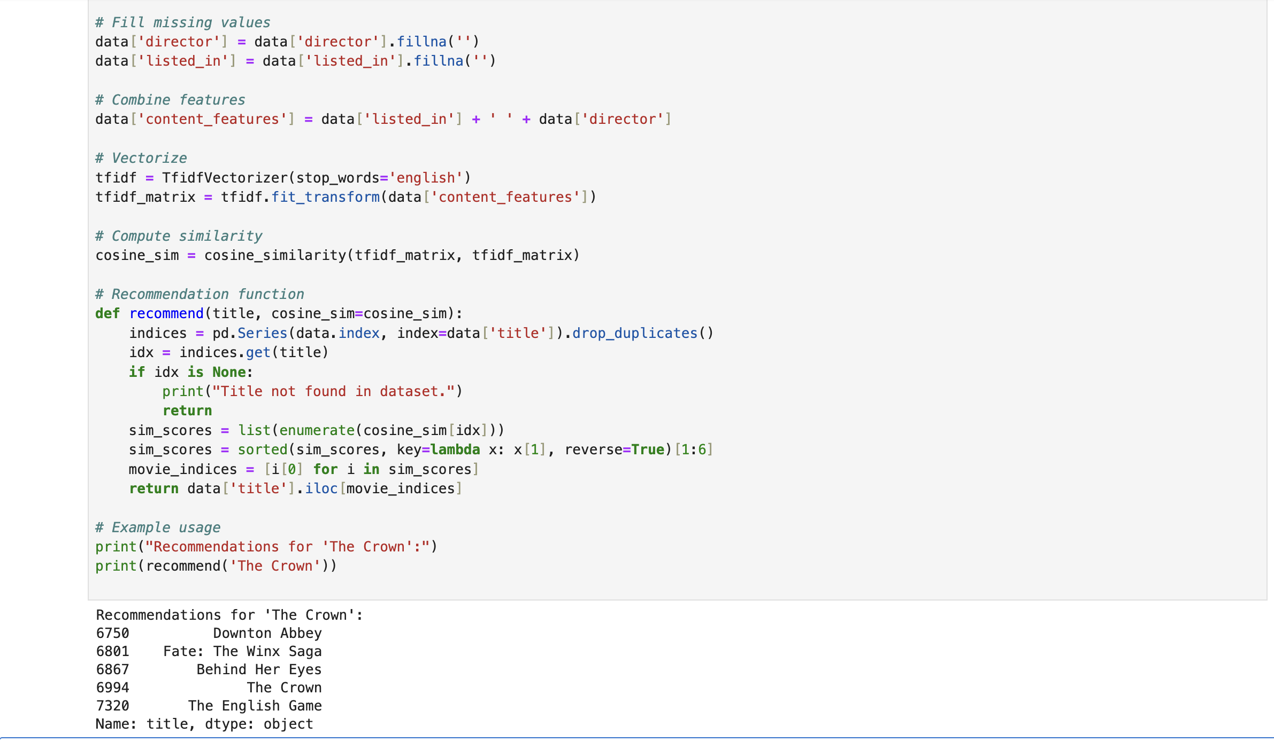
Recommendations for 'The Crown'

Slide 20
Key Insights from Netflix
Analysis
Understanding Netflix’s Data Driver Success
• Data Analytics as a Core Strategy
• Importance of Data Cleaning
• Visualization for Insight
• Machine Learning for Personalization
• Challenges in Data Management

Slide 21
